Slide 1
IBM University Engagement Project Submission
“Exploring the Power of Agentic AI with IBM Cloud and Orchestrate”

Slide 2

Project Tile – [Course Content Simplification Agent]
Domain of Project – [Education]
Student Name | Recent Passport Photo | Email ID | Mobile number [WhatsApp]
SUDDALA SUJAL |  | suddalasujal@gmail.com | 9347899783

Slide 3
Problem Statement - Course Content Simplification Agent
The Challenge
Academic materials are often written with varying levels of complexity.
Beginners may struggle to understand advanced terminology and concepts.
The same content is not equally suitable for beginner, intermediate, and expert learners.
Students spend additional time searching for simpler explanations.
There is a need for an AI system that can adapt explanations according to learner proficiency.
The Objective
To Build an AI-powered Course Content Simplification Agent that:
Analyzes academic content.
Identifies the complexity of the material.
Reframes explanations according to learner proficiency.
Provides Beginner, Intermediate, and Expert level explanations.
Makes complex educational content easier to understand.

Slide 4
Proposed Solution -
Title:
AI-Powered Course Content Simplification Agent
The proposed solution is an AI-powered Course Content Simplification Agent built using IBM Bob, IBM watsonx.ai, and IBM Granite.
Content Analysis: Extracts and analyzes academic content from uploaded documents.
RAG-Based Retrieval: Retrieves relevant information from the provided learning material.
Granite-Powered Generation: IBM Granite generates clear and concise explanations.
Learner Personalization: Reframes content for Beginner, Intermediate, and Expert learners.
Simplified Output: Converts complex academic concepts into easy-to-understand explanations.
Interactive Access: Provides a web-based interface for uploading and processing course content.
Goal: Make complex academic content easier to understand without losing its core meaning.

Slide 5
Technology Used
IBM Bob – Used for AI-assisted project development and implementation.
IBM watsonx.ai – Platform used to access and integrate the Granite foundation model.
IBM Granite – LLM used for understanding and simplifying academic content.
Python – Backend development and PDF content processing.
Flask – Lightweight web backend/API for the application.
HTML/CSS/JavaScript – Frontend interface for PDF upload and displaying results.
PDF Processing – Extracts text from uploaded academic PDF documents.
Render – Cloud platform used to deploy the web application.
Bottom line:
IBM Granite + watsonx.ai + Python + Web Application

Slide 6
Orchestrate component Used -
1) File Upload / Input Component
Allows users to upload academic PDF documents for processing.
2) PDF Text Extraction Component
Extracts readable text from the uploaded course material.
3) IBM watsonx.ai Agent
Processes the extracted content using IBM Granite to generate simplified explanations.
4) IBM Granite Model
Provides natural-language understanding, summarization, and content simplification.
5) Web Output Component
Displays the generated simplified content to the user through the web interface.
6) Render Deployment
Hosts and provides access to the deployed web application.

Slide 7
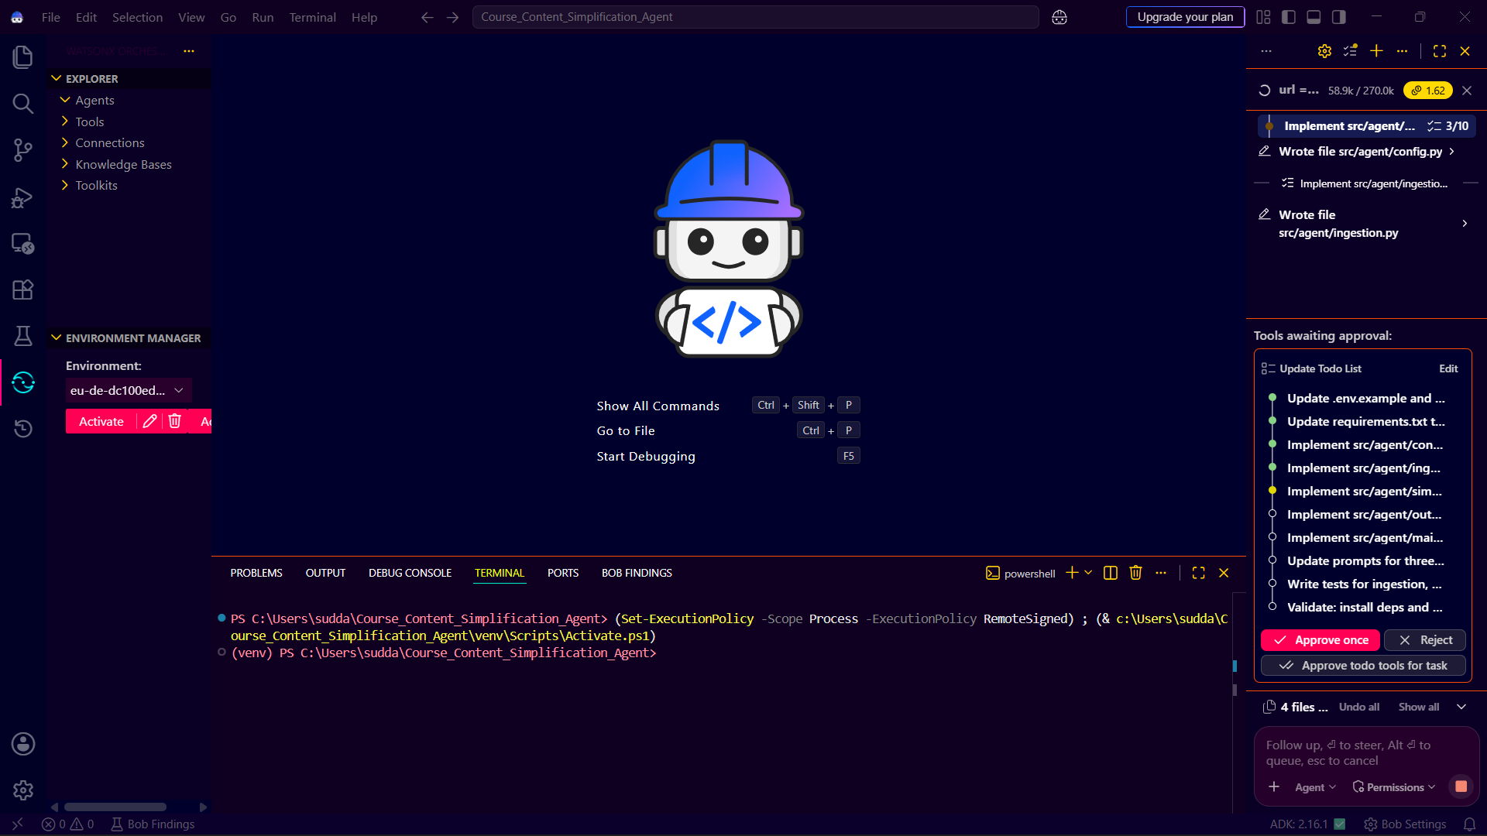
Agent Instructions Screenshot-

Slide 8
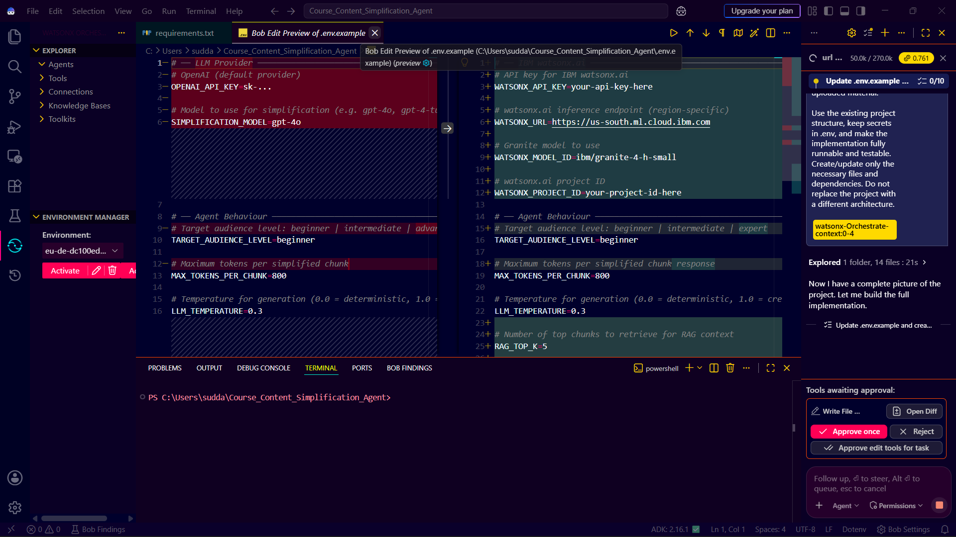
Document Uploaded Screenshot (If applicable)-

Slide 9
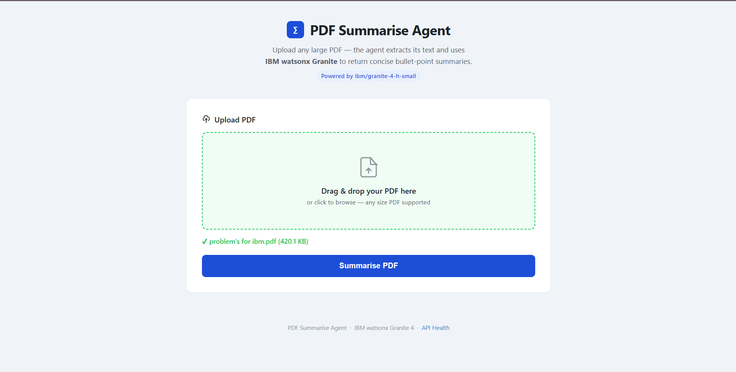
Output Screenshot:

Slide 10
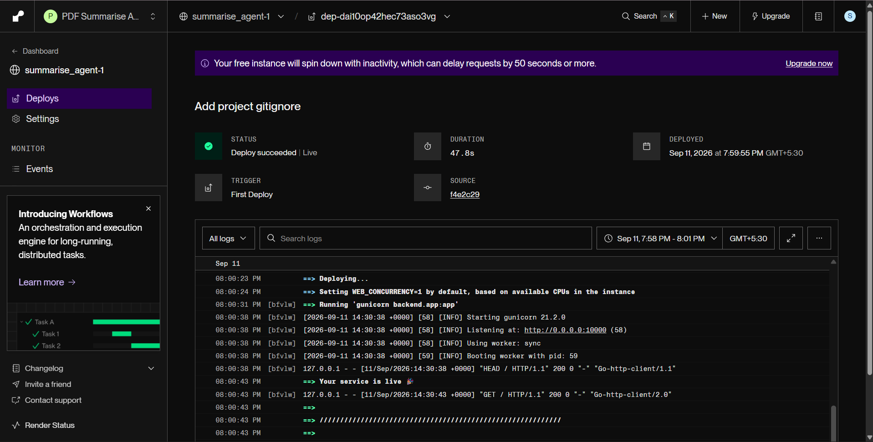
Other Applicable Screenshots:
DEPLOYED SUCCESSFULLY

Slide 11
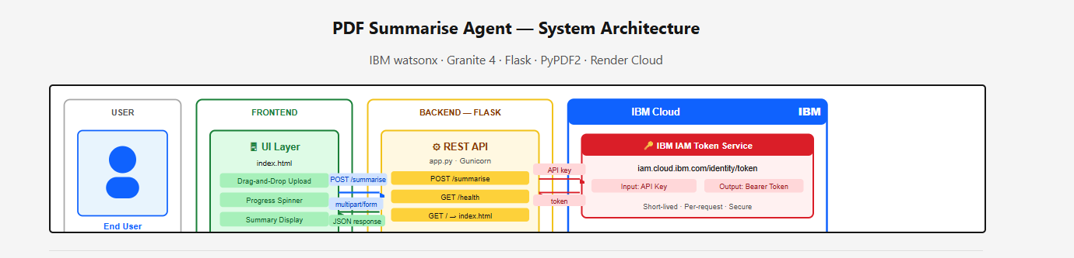
Orchestrate architecture blueprint

Slide 12

Role of Agentic AI in the solution
Role of Agentic AI in Course Content Simplification Agent
Agentic AI enables the system to process academic content intelligently and generate simplified explanations based on the user's learning needs.
Content Understanding: Analyzes uploaded academic PDF content and identifies important concepts.
Intelligent Processing: Uses IBM watsonx.ai and IBM Granite to understand and transform complex educational content.
Task Execution: Performs content extraction, analysis, summarization, and simplification as part of the workflow.
Learner Adaptation: Can structure explanations according to Beginner, Intermediate, or Expert proficiency levels.
Context-Aware Generation: Maintains the key meaning of the original material while producing clearer explanations.
Goal-Oriented Output: Produces concise, easy-to-understand educational content instead of simply returning the original text.
Overall: Agentic AI makes the solution intelligent, adaptive, and goal-oriented, helping learners understand complex academic material more easily.

Slide 13
Novelty and Uniqueness
The proposed Course Content Simplification Agent stands out by using IBM Granite and AI-powered content processing to transform complex academic material into concise and easy-to-understand explanations.
Academic Content Simplification – Converts complex educational material into clear, concise explanations while preserving the core meaning.
Granite-Powered Intelligence – Uses IBM Granite through watsonx.ai for natural-language understanding and generation.
PDF-Based Processing – Accepts academic PDF documents and extracts their textual content for intelligent processing.
Context-Aware Summarization – Generates summaries based on the actual content provided by the learner rather than generic explanations.
Learner-Friendly Output – Presents important concepts in a structured, readable format that reduces unnecessary complexity.
Automated Processing – Combines document processing and AI generation into a single workflow, reducing manual effort.
Web-Based Accessibility – Provides a simple interface where users can upload academic material and receive simplified content.
Cloud Deployment – The solution is deployed as a web application, making the agent accessible through the internet.
Overall: The solution provides a simple, intelligent, and accessible approach to making complex academic content easier to understand.

Slide 14
Git Hub Link
GitHub Repository:
https://github.com/Sujalss5/summarise_agent
·
·
·

Slide 15
Future Scope
AI-Powered Voice Assistant & Multilingual Support –
The system can be enhanced with voice interaction and multilingual support, allowing students to ask questions and receive simplified explanations in their preferred language. This will improve accessibility and make the Course Content Simplification Agent more useful for learners from diverse linguistic backgrounds.
2. Interactive Personalized Learning –
The agent can be extended to provide personalized explanations, examples, follow-up questions, and quizzes based on the learner’s proficiency level. This will help students move beyond simple summarization and use the system as an interactive AI learning assistant.
·
·
·

Slide 16
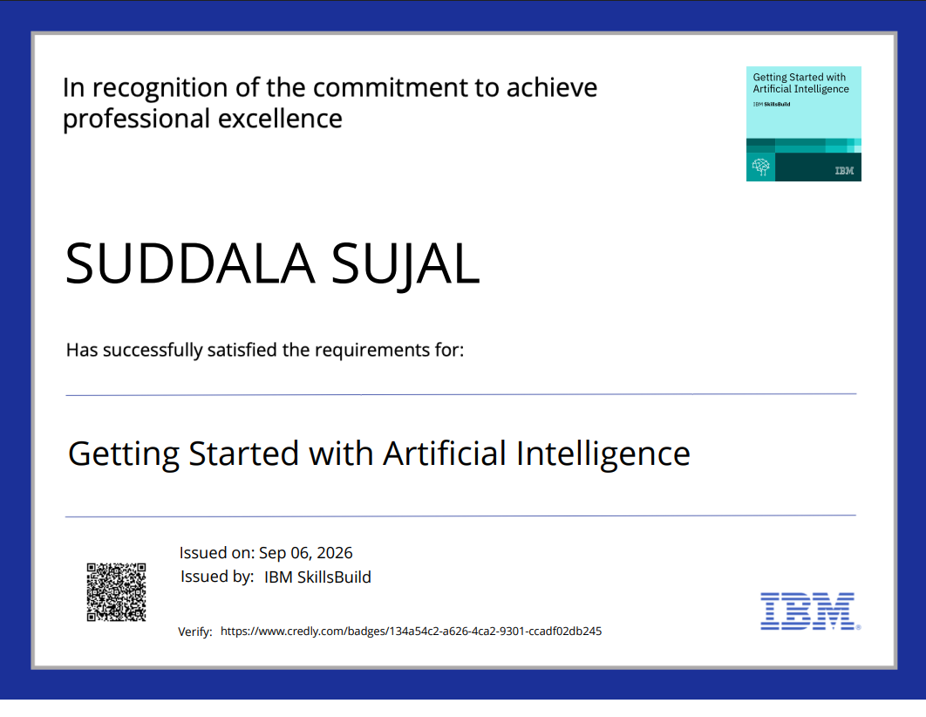
Certificates Earned:
Please add your credly certificate

Slide 17
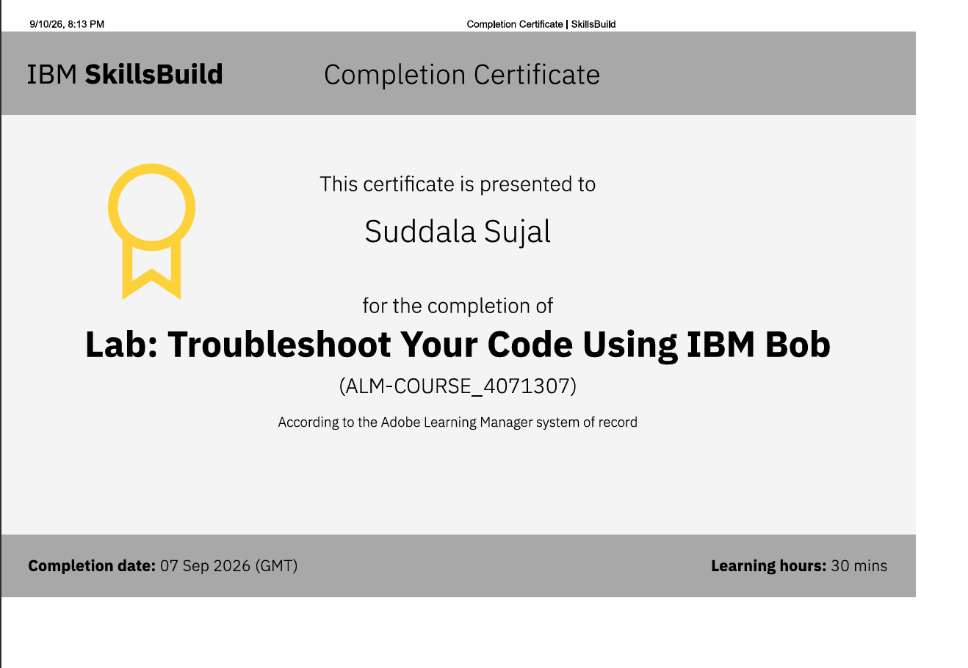
Certificates Earned:​
Add your IBM BOB Certificate

Slide 18


